Slide 1


THE MASTECH INFOTRELLIS ADVANTAGE
INFORMATION MANAGEMENT CONSULTING AND TECHNOLOGY

Slide 2



MASTECH INFOTRELLIS INTRODUCTION
A Timeline of Success
Background
People
Thought Leadership
Services Portfolio
Technical and Functional Practices
Delivery Methodology
Service Accelerators
Products
Sample Client List

Slide 3
A Timeline Of Success
EXPANSION OF BIG DATA PRACTICE
Rapidly expanding Big Data Practice through addition of new Customers
INFOTRELLIS BECOMES MASTECH INFOTRELLIS
Mastech Digital Acquires InfoTrellis. Launch of Digital Transformation Services.
2016
2017
EXPANDING INTO NEW GEOS AND INDUSTRIES
New Logos Added in South Africa, Europe
2014
2015
NEW PRODUCT IMPLEMENTATIONS
First Implementation of AllSight and Veriscope
LAUNCH OF MULTIPLE NEW PRACTICES
Helping clients with new services around EDI, DQ Technologies
EXPANSION OF PRODUCT PORTFOLIO
Launch of AllSight CIMS Team
2012
2013
GLOBAL REACH CAPABILITY
Opening of Chennai Center to Enhance Delivery Capability
PRODUCT DIVISION ESTABLISHED
Established Master Data Analytics Team (Veriscope)
2010
2011
LAUNCH OF ‘SMART MDM’
A highly successful multi-phase MDM Implementation methodology
SUCCESS ACROSS VERTICALS
New Logos Across Insurance, Banking
2008
2009
IBM ACQUIRES DWL
InfoTrellis founders are integral part of the roadmap from CDI to MDM
INFOTRELLIS FOUNDED
Helping businesses realize the true value of their Enterprise Data Assets
2005
2007
DWL LAUNCHES FIRST CDI SOLUTION
InfoTrellis founders are the lead architects
DWL CDI SOLUTION RECOGNIZED AS ‘VISIONARY’
Becomes #1 CDI application globally
1999
2003

Slide 4

Background
Mastech InfoTrellis was started in 2007 by three original MDM Architects who developed IBM MDM Server while at IBM/DWL Inc. in Toronto
Successful track record in exceeding our customer’s expectations many of whom are Fortune 500 firms; Technology skillsets include MDM, ETL, Big Data, Data Quality, Data Profiling, Integration, Quality Assurance and Business Analysis
Expertise in all editions of InfoSphere MDM – Standard Edition (Initiate), Advanced Edition (MDM Server) and Collaboration Edition (PIM)
We have served leading clients from the banking, insurance, healthcare, retail, automotive and telecom industries across US, Canada, Greece, and South Africa
We are an IBM business partner and reseller and maintain a strong relationship with the MDM engineering group

Slide 5

Our People
Investing heavily in hiring and training the best people for our various practices across geographies; 225+ consultants in Canada, US , India and growing
Our hiring philosophy is not to hire when in doubt; our hire to reject ratio is 1:50; once selected consultants undergo focused training and certification process
We have a very healthy mix of senior, intermediate and junior resources across competencies, with over 90% retention rate which is one of the best in the industry
We are a diverse team with more than half a dozen nationalities, who have lived and worked in various continents including North America, Europe, Asia, and Africa

Slide 6

Thought Leadership
Given our long history in this space, we bring a holistic yet practical thought leadership to data management programs. Our competence in MDM ecosystems is unparalleled and we offer industry domain and technology competence required for its success
Mastech InfoTrellis MDM Veriscope is our completely unique reporting & operational monitoring product for MDM, the only product available with the ability to track data quality trends, performance and business analytics on customer data
Experience from our many successful MDM implementations is captured and made available in assets such as Smart MDM™ (our MDM Solution Delivery Methodology), Service Tester™ tool, 100’s of MDM Server test cases
Automated code review tools for Informatica and DataStage, pre-built DataStage and Informatica packages to speed up ETL work for MDM projects

Slide 7
Services Portfolio
Performance Tuning
Needs
Assessment
Production Support
MDM Strategy
PROGRAM STRATEGY
MDM support
Services Portfolio
Health Check
PROGRAM roadmap
MDM Implementation
Solution Architecture
Solution Upgrade
Option 1:
For MDM Clients Only
Design and Implementation

Slide 8
Services Portfolio
PERFORMANCE TUNING
NEEDS ASSESSMENT
PRODUCTION SUPPORT
Big
Data
Master Data Management
Support
Strategy
PROGRAM STRATEGY
Information Management
HEALTH CHECK
PROGRAM ROADMAP
Data Quality
& Profiling
Data
Integration
SOLUTION ARCHITECHTURE
Implementation
SOLUTION UPGRADE
Option 2:
For MDM Clients Only
DESIGN AND IMPLEMENTATION

Slide 9




Technical and Functional Practices
Master Data Management
InfoSphere MDM Server SE (Initiate MDS)
InfoSphere MDM Server AE (MDM Server)
InfoSphere MDM Server CE (PIM)
InfoSphere MDM Reference Data Management
Data Integration
InfoSphere DataStage
Netezza
Informatica
Microsoft SSIS
WebSphere Cast Iron
SAP PI
Data Quality and Profiling
Mastech InfoTrellis Veriscope
InfoSphere Information Analyzer
Informatica Data Quality
Big Data
Mastech InfoTrellis AllSight
Cloudera
Hortonworks
BigInsights
Apache Hadoop
Quality Assurance
Business Analysis
Program Management

Slide 10
Technical and Functional Practices
Master Data Management
IBM MDM
IBM RDM
Microsoft MDM
Informatica MDM
Data Integration
Microsoft SSIS
IBM DataStage
Netezza
Informatica ETL
Talend
WebSphere Cast Iron
SAP PI
Data Quality, Profiling and Reporting
Microsoft SSRS
Microsoft Power BI
Microsoft SSAS
IBM Cognos
Tableau
Mastech InfoTrellis Veriscope
IBM Information Analyzer
Informatica Data Quality
TIBCO Spotfire
Big Data
Mastech InfoTrellis AllSight
Cloudera
Hortonworks
BigInsights
Apache Hadoop
Quality Assurance
This version is sent to OCOT client
Business Analysis
Program Management

Slide 11
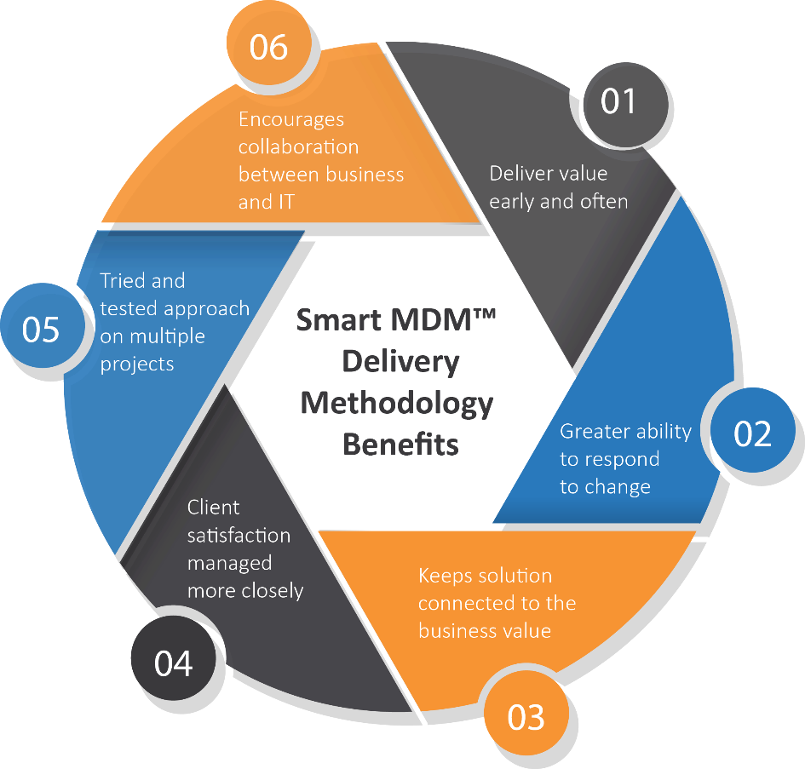
Smart MDMTM Delivery Methodology
Mastech InfoTrellis Smart MDM™ is a common sense approach based on parts of Rational Unified Process (RUP) and Agile development methodologies
It blends deliverables with accountability and requires customer focused teams to collaborate and deliver a high-quality MDM solution
It provides tried and tested methods to ensure success for MDM programs
Option 1:
For MDM Clients Only

Slide 12
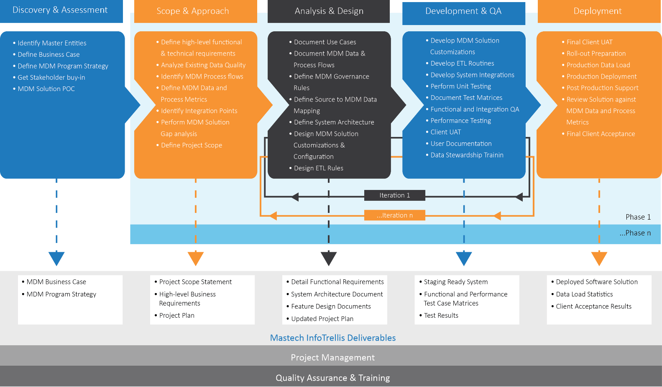
Smart MDMTM Phases
Option 1:
For MDM Clients Only

Slide 13
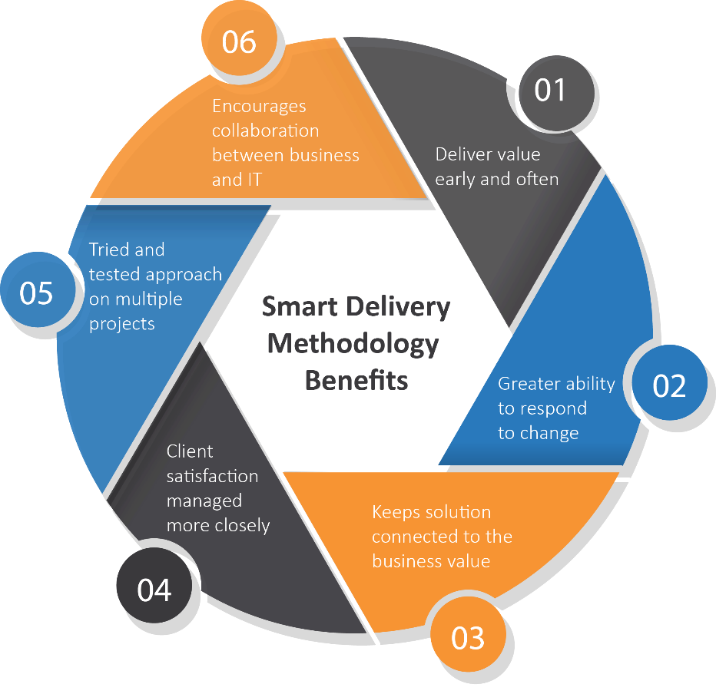
Smart Delivery Methodology
Mastech InfoTrellis Smart delivery methodology is a common sense approach based on parts of Rational Unified Process (RUP) and Agile development methodologies
It blends deliverables with accountability and requires customer focused teams to collaborate and deliver a high-quality information management solution
It provides tried and tested methods to ensure success for information management programs
Option 2:
For All Services Clients

Slide 14
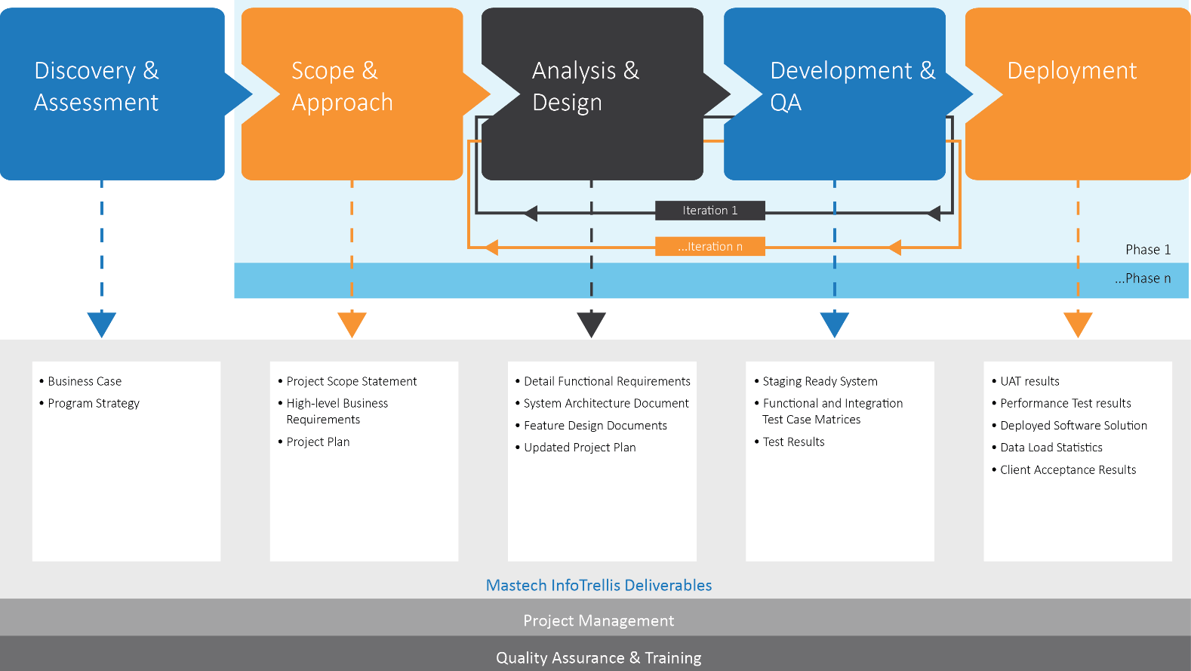
Smart Delivery Methodology
Option 2:
For All Services Clients

Slide 15




Service Accelerator
Quality Assurance
ITLS Service Tester
ITLS XML Generator
ITLS Batch XML Validator
ITLS Comparator
ITLS Auto UI
ITLS DB Reporter
Enterprise Data Integration
ITLS DataStage Code Review Tool
ITLS Informatica Code Review Tool
ITLS Unit Test Data Generator
Master Data Management
ITLS MDM Unit Test Tool
ITLS Quality Stage Tester

Slide 16
Products
VERISCOPE
An offering designed to optimize MDM, Data Quality, and Data Governance programs
ANALYTICS
DASHBOARDS AND REPORTS
ALERTS
AD HOC QUERIES
100+ preconfigured scans
Over 15 parameter driven reports
Multi-channel notifications
Prescriptive star schema
ACTIONABLE
EXTENDIBLE
CONFIGURABLE
CONSUMABLE
Directly supports IT, stewards, councils
Open architecture
Tooling makes it simple
Short time to value (4 weeks)
Incorporate over a decade of experience and best practices in MDM

Slide 17
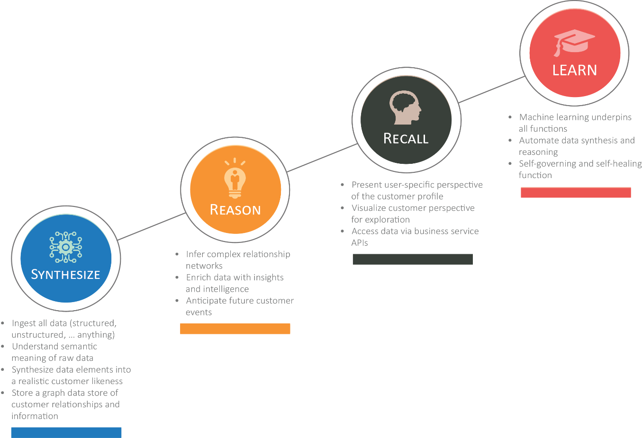
Products
Continuous Evolution of Customer Intelligence
AllSight Customer Intelligence Management System
Incorporates over 15 years of best practices and experiences in customer data management

Slide 18


























Client List

Slide 19






LEADERSHIP TEAM
Moo Abbas – Head, Mastech InfoTrellis
Sachin Wadhwa – Head – Operations, Mastech InfoTrellis
Zahid Naeem - (TBR)
Dave Borean – (TBR)
Kumaran Sasikanthan – (TBR)
Notes:
Moo Abbas – CEO & Co-Founder
Sachin Wadhwa – COO & Cofounder
Zahid Naeem – CTO & Cofounder
Dave Borean – VP Products
Kumaran Sasikanthan – VP Consulting Services

Slide 20

Leadership Team
As the head of Mastech InfoTrellis business, Mahmood Abbas (Moo) is responsible for revenue growth and profitability of the business unit. He comes with rich experience in enterprise software development. Moo co-founded InfoTrellis, before the company got acquired by Mastech Digital. During his stint as the CEO of InfoTrellis, Moo guided both product delivery and architecture of the leading MDM product solution in the master data industry, IBM’s InfoSphere MDM Server. Earlier, at IBM, Moo led a 150-person global development team across Canada, USA, India, and UK. Moo specializes in undertaking technical due diligence and has helped clients across various industries with their MDM strategy and implementations.
Moo holds a degree in Mathematics from York University and a diploma in Computer Sciences from Seneca College of Applied Arts and Technology.
Moo has functional experience in Corporate Strategy, Technology Strategy, Program and Project Leadership, and MDM Strategy and Solution Architecture.
Moo Abbas – Head, Mastech InfoTrellis
Functional Experience
Corporate Strategy
Technology Strategy
Program and Project Leadership
MDM Strategy and Solution Architecture

Slide 21
Leadership Team
Sachin oversees the business operations at Mastech InfoTrellis and focuses on delivering higher efficiencies to customers through strong governance in the company across finance, HR and administration. Throughout his career, he has anchored large programs in enterprise application architecture and product development in the areas of Customer Data Integration and Master Data Management. Prior to co-founding InfoTrellis, a company that Mastech Digital acquired, Sachin worked at IBM, guiding product delivery and some of the first deployments of IBM InfoSphere MDM Server. Sachin had earlier joined IBM as part of its acquisition of Toronto-based DWL, where he was the lead Architect and was instrumental in shaping the CDI space.
At Mastech InfoTrellis, Sachin also doubles up as a program director, helping clients from various industries in defining and implementing their MDM strategy.
Sachin holds an MBA degree from Rotman School of Management and an M.Sc. in Computer Science from University of Delhi.
Sachin Wadhwa – Operations Head, Mastech InfoTrellis
Functional Experience
Corporate Finance and Global Operations
Global Delivery Strategy and Execution
Program and Project Leadership
MDM Strategy and Solution Architecture

Slide 22
Leadership Team
Zahid is the Chief Technology Officer and Co-Founder of InfoTrellis. He has many years of experience in enterprise software development and consulting. Prior to founding InfoTrellis, Zahid was the Lead Architect at IBM, working on InfoSphere™ MDM Server. At IBM, he played a major role in product development and provided consulting services to help clients maximize MDM Server capabilities to realize their CDI/MDM strategy. Zahid joined IBM as part of its part of its acquisition of Toronto-based DWL, where he was the Lead Architect and was instrumental in shaping the CDI space.
At InfoTrellis, Zahid defines our technology vision and roadmap. He sets the standards for our service delivery and drives various global initiatives across competencies to maintain and enhance our technical leadership. He sets the standards for our services and product delivery and drives various global initiatives across competencies to maintain and enhance our technical leadership. Zahid holds a Master of Science degree in Industrial Engineering from State University of New York at Buffalo and a Bachelors of Science degree in Mechanical Engineering from University of Engineering and Technology, Lahore.
Zahid Naeem – TBR, Mastech InfoTrellis
Functional Experience
Technology Leadership and Strategy
Sales Enablement and Customer Adoption Programs
Big Data Strategy and Mentorship
Program and Project Leadership
MDM Strategy and Solution Architecture

Slide 23
Leadership Team
Dave is the Vice President of Products at InfoTrellis. He has many years of experience working on the architecture and development of mission-critical enterprise applications in both the product and custom solution spaces. Dave came from IBM where he was a Senior Technical Staff Member responsible for leading the InfoSphere MDM portfolio of products and working directly with clients from around the world.
At InfoTrellis, Dave heads the Products division, driving the strategy, conception, development, launch and marketing of our Products. In this role he manages our relationships with customers, partners and analysts.
He designs and runs the sales enablement and customer adoption programs of our products; he also guides the product development team in the architecture, design and development of our products. Dave holds a degree in Math and Computer Science from University of Waterloo.
Dave Borean – TBR, Mastech InfoTrellis
Functional Experience
Product Strategy and Marketing
Sales Enablement and Customer Adoption Programs
Big Data Strategy and Mentorship
Development and Launch of New Products
MDM Strategy and Solution Architecture

Slide 24
Leadership Team
Kumaran heads the InfoTrellis Consulting Services division. He has many years of experience in software product management, marketing, enterprise application consulting and software development. Prior to InfoTrellis, he was a Senior Manager for Product Management and Marketing at Software AG where he helped launch multiple releases of market leading SOA Governance products. Over the years, he has worked with clients across a range of industries from North America, EMEA and Asia.
At InfoTrellis, Kumaran defines and executes the strategy for the company’s services division. In addition to leading our global services teams, he doubles up as the head of our office in India. He holds an MBA from INSEAD and an MS in Computer Science from Delhi University.
Kumaran Sasikanthan – TBR, Mastech InfoTrellis
Functional Experience
Product Management and Marketing
Program Management
Building High Performance Teams
Enterprise Applications Consulting

Slide 25

CASE STUDIES
01 Leading US Retailer with over 1100 stores
02 World’s leading Medical Device Manufacturer
03 Multinational Hi-Tech Company

Slide 26

Case Study: 01 Leading US Retailer with over 1100 stores
Business Situation
Client owned a legacy CIF (mainframe) with an architecture that was cumbersome to modify, requiring long running IT projects. This legacy system needed significant changes to meet future business needs
Customer updates were delayed resulting in stale data for customer touch-points, marketing and analysis
Excessive time was spent in customer setup for online application and there were delays in modifying business rules
Business needed a single, accurate, comprehensive and up-to-date view of the customer that is shareable across various lines of business
Mastech InfoTrellis Solution
After multiple rounds of due-diligence, the client chose us over multiple large SI's as the sole provider for all of their MDM projects
We were engaged right from the initial stage, where we helped with the tool selection and assisted the client in various POC’s
We defined the business & technology roadmap, planned a multi-phased multi-year program sun setting existing mainframe application
Built their MDM solution from scratch which integrated with 185 touch points and successfully upgraded the solution to the latest IBM MDM version
Currently executing many Data Integration projects for various business units
KEY ACCOMPLISHMENTS:
Implemented new CDI Solution which sits in the middle of the core IT enterprise stack that supports the busy.com site and feeds near real time data to Teradata for analytics
Migrated 120 Million customers and 185 touch-points to new CDI architecture using MDM Server
Cut client’s IT spending on MDM program to 1/3rd of the original budget by efficient use of onsite and offshore teams

Slide 27
Case Study: 02 World’s Leading Medical Device Manufacturer
Business Situation
The client had embarked on the path to Supply Chain 2020. Some of the key initiatives of this program were better Product Lifecycle Management, Accurate Product Forecasting, Analytics and streamlining the Supply Chain
On its way to becoming the world’s leading medical device manufacturer, the client had acquired various other medical device companies. The product information was flowing from various disparate sources and in different formats. Given the wide and ever-expanding range of products, getting a single unified view of the product was a vital need for the client’s Supply chain 2020 program
Also, there was a need to automate the submission process of regulatory information to FDA server, in order to comply with the FDA GUDID regulations
Mastech InfoTrellis Solution
Mastech InfoTrellis engaged with the client from the initial stages of the multi-phase program in performing various assessments across different lines of businesses and providing expert insights before implementing the MDM solution. Based on the Current state assessment, Mastech InfoTrellis defined the Program Strategy and Roadmap for the client
In the first Phase, a solution was provided which involved a global Item repository that supports the Supply chain 2020 program. The IBM InfoSphere MDM Advanced Edition – Product domain, was chosen for this purpose
In the second phase of the program, Mastech InfoTrellis customized the MDM data model and services to persist the labelling and regulatory information related to the products. BPM workflows were developed to ensure the sanctity of data being sent to the FDA GUDID servers
The 3rd Phase of the project is in progress, This starts the chain of projects where each of the client’s major data sources will be integrated with the MDM solution provided by Mastech InfoTrellis and MDM will be at the center of all product data. In this phase, we also developed BPM workflows to streamline the NPI (New Product Introduction) process.
KEY ACCOMPLISHMENTS:
Designed and developed the MDM item repository and the integration layer using SAP PI. Customized the OOTB Product UI and Admin UI for product management
MDM and SAP PI codes were tuned for optimum performance based on the insights gained from Performance testing
The client was recently acquired by another major medical device manufacturer. During the merger, an evaluation was done between the client’s MDM solution and that of the acquirer. The solution provided by Mastech InfoTrellis was chosen as the better of the two on all judgement parameters.
The UDI solution provided by Mastech InfoTrellis submitted 30k records successfully with the FDA GUDID system within 3 weeks. In contrast, the client’s acquirer had a UDI solution which was able to submit 10k records in a span of 2 months
NPI process with multiple levels of approvers developed using BPM workflows.

Slide 28
Case Study: 03 Multinational Hi-Tech Company
Business Situation
Keeping Customer experience as a key focus area, the client had initiated the Customer MDM program to improve the quality of service
The client had data records numbering in billions, coming in from 20 source systems across the world. This data had typical data quality issues and needed to be cleaned, standardized and de-duped. The Probabilistic matching algorithm design from their initial attempt was not delivering the desired results and hence had to be re-done
During the initial attempt to create the Customer Hub, IBM Initiate was selected. However, the limitations introduced in the MDM program roadmap inhibited optimum results and key stakeholders were reluctant to adopt the new system
One of the biggest challenge in the project was the client’s requirement for this project to be done within an year. This was a big challenge given the volume of data which was in billions and multiple geographies that wanted to adopt this solution
Mastech InfoTrellis Solution
Mastech InfoTrellis was engaged to evaluate the enterprise customer hub solution provided by another vendor. Based on the detailed assessment report, the client requested Mastech InfoTrellis to take ownership of the MDM program and define a new MDM roadmap
Mastech InfoTrellis team devised a first of a kind solution which involved combining the power of Probabilistic Matching provided by IBM Initiate with precision and robustness of IBM MDM AE Server design for more than 1.2 billion customers and organizations and also built ETL routines for both Initial & Delta loads.
Mastech InfoTrellis team travelled to various client locations around the globe and met with the business users to showcase the results of Bulk Cross Matching and further tune the Probabilistic Matching Algorithm
KEY ACCOMPLISHMENTS:
Implemented an MDM solution using IBM MDM AE and migrated over 1.2 billion customer and organization records, setting a record for one of the largest MDM implementations worldwide
Built integrations with more than 20 source systems and 2 new downstream systems while laying foundation for future development moving towards a Service Oriented Architecture (SOA)
Probabilistic Matching Algorithm was designed and tuned to meet the client expectations in each major Geographic location – AMER, LATAM, APAC and EMEA by conducting multiple user workshops across the different geographies
Customer Account Master (CAM) implemented on a separate MDM v11 platform – Outcome of successful implementation of AE hub

Slide 29

Appendix
Mastech InfoTrellis Roles and Responsibilities

Slide 30
Appendix
Role
Responsibilities
Strategy Consultant
Build vs. buy decision
Define MDM hub style
Define roadmap for desired goals
Oversees the overall solution
Solution Architect
Offers in-depth knowledge of the MDM and ETL products
Provides architecture perspective at enterprise scale
Provides mentorship for strategic results
MDM Sr. Product Consultant
Offers insights for MDM data model, services & business usage
Responsible for creation of master data entities business views
Works with client’s data management group
Provides analysis for matching, quality and standardization rules of legacy enterprise master data
MDM Lead
Highly experienced in MDM implementations
Establish overall implementation view, identify major system interfaces and development of reusable modules
Highly knowledgeable with MDM services, data model & technical features
Highly Skilled in tuning matching algorithms
MDM Developer
Hands-on experience with MDM implementations
Responsible for build, tuning and testing of customized MDM applications
Ability to resolve coding and other integration issues
Provides documentations where applicable

Slide 31
Appendix
Role
Responsibilities
Build Engineer
Experienced with release management and related processes.
Works with development and test teams to provide builds for project deliveries
ETL Lead
Highly experienced with ETL implementation and data quality process
Experienced with ETL tools like DataStage, Informatica
Highly knowledgeable with MDM data model and MDM physical layer constraints
ETL Developer
Experienced with ETL implementation and data quality process
Experienced with ETL tools like IIS – DataStage, Informatica
Good understanding of MDM data model and MDM physical layer constraints
QA Lead
Experienced in QA strategy, Planning Test cases and executions and running UATs
Expert in developing and executing MDM test cases
Experienced in SOA testing methodology
Extensive experience with test tools and test result analysis
QA Tester
Experienced in developing and executing MDM test cases
Experienced in SOA testing methodology
Hands-on experience with test tools and test result analysis
Project Manager
Accountable for successful MDM solution delivery
Works with Clients Project manager to manage project cycle

Slide 32
Appendix
Role
Responsibilities
Overall accountability for the project
Liaises with client leadership and InfoTrellis leadership and delivery teams to steer the program
Client advocate within InfoTrellis
Initiates and Leads discussions on CRs and SOWs
1st point of escalation for any issues in the program
Very Experienced Delivery Manager
Principal
ESB Lead
Experienced in Distributed Computing, Enterprise Application Integration (EAI), Service Oriented Architecture (SOA), Enterprise Service Bus (ESB)
Knowledgeable with MDM data model and MDM physical layer constraints.
Knowledgeable with real time, near real time and batch integration frameworks
DQ Lead
Experienced in Data Profiling tools such as Information Analyzer, Informatica Data Quality and MDM Veriscope.
Strong SQL and database skills
Highly knowledgeable in Data Quality issues and solutions
Installation, administration, troubleshooting, maintenance, and performance-tuning of the MDM Server environment
Setup and tune Dev, QA, Pre Prod and Production environments for MDM Server
Experience in the technical design and capacity planning on application platforms
Experience in administrating IBM WebSphere application server (WAS)
Experience in High Availability implementation
Infrastructure Lead

Slide 33

Questions?

Slide 34

THANK YOU
CLASSIFIED

